Slide 1

Breast Cancer Detection Using Machine Learning Alok kumar Rudra Prakash Pandey shashwat gupta, B.Tech. in Computer Science Engineering Gurukula Kangri (Deemed to be University)

Slide 2
content
Introduction
Methodology
Models Implemented
Model Performance
Challenges Faced
Discussion and Insights
Conclusion

Slide 3
Introduction
Objective:
To develop machine learning models that classify breast cancer cases as benign or malignant with high accuracy and reliability.
Early detection can significantly improve treatment outcomes and survival rates.
Motivation:
Breast cancer is one of the leading causes of cancer-related deaths worldwide.
Traditional diagnostic methods (e.g., biopsies) can be time-consuming, expensive, and prone to human error.
Machine learning offers the potential to:
Automate the diagnostic process.
Enhance accuracy.
Provide real-time decision support to clinicians.

Slide 4
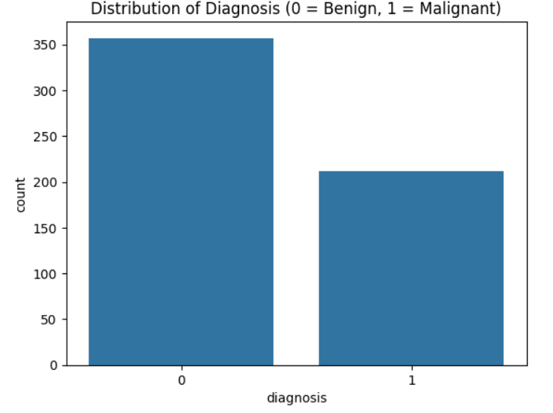
Methodology
Models
Logistic Regression: Linear model for binary classification.
Random Forest: Ensemble of decision trees, robust to overfitting.
SVM: Finds optimal hyperplane for class separation, effective for complex data.
KNN: Classifies based on proximity to neighbors, simple and intuitive.
Dataset Description
Breast Cancer Wisconsin Dataset:
569 samples, 30 features, 2 classes (Malignant, Benign).
Features derived from cell nuclei characteristics: radius, texture, area, smoothness, etc.
Preprocessing
Implementation Workflow
Data Cleaning: Removed non-predictive id column.
Encoding: Target converted to binary (Malignant = 1, Benign = 0).
Scaling: Standardized features using StandardScaler to ensure equal contribution.
EDA: Explored patterns using correlation matrices, histograms, and pair plots.
Data Split: 80% training, 20% testing.
Training: Tuned hyperparameters for optimal performance.
Evaluation Metrics: Accuracy, Precision, Recall, F1-Score for comparative analysis

Slide 5
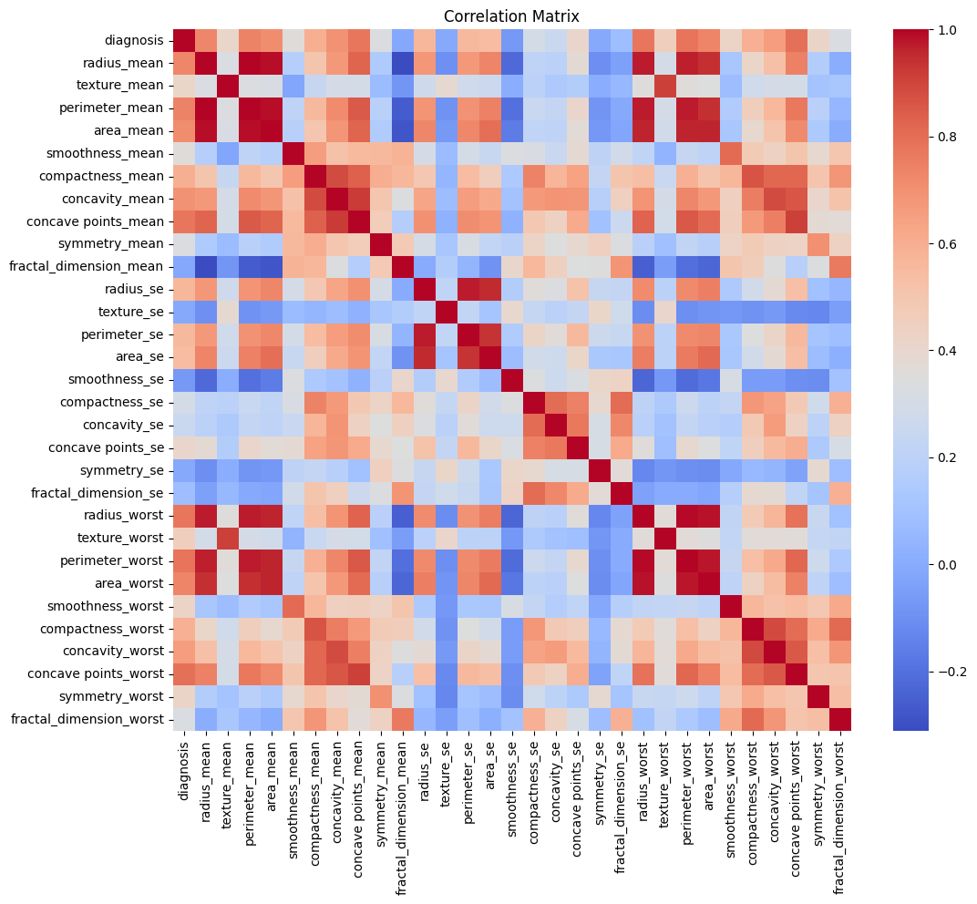
Models Implemented
Models Evaluated
Logistic Regression
Random Forest
Support Vector Machine (SVM)
K-Nearest Neighbors (KNN)
Feature Engineering
Correlation heatmap for key predictors (radius, perimeter, area)

Slide 6
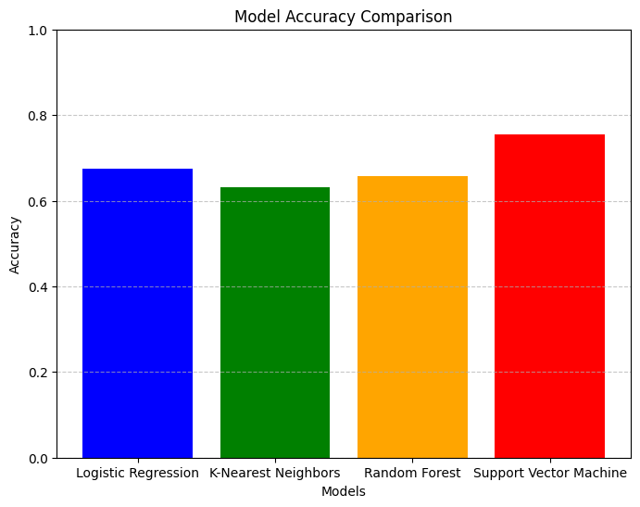
Model Performance
Key Metrics: Accuracy, Precision, Recall, F1-Score
Model | Accuracy | Precision | Recall | F1-Score
Logistic Regression | 65% | Moderate | Lower | Fair
Random Forest | 75% | High | Improved | Strong
SVM | 80% | Highest | Excellent | Best
KNN | 65% | High | Excellent | Remarkable

Slide 7
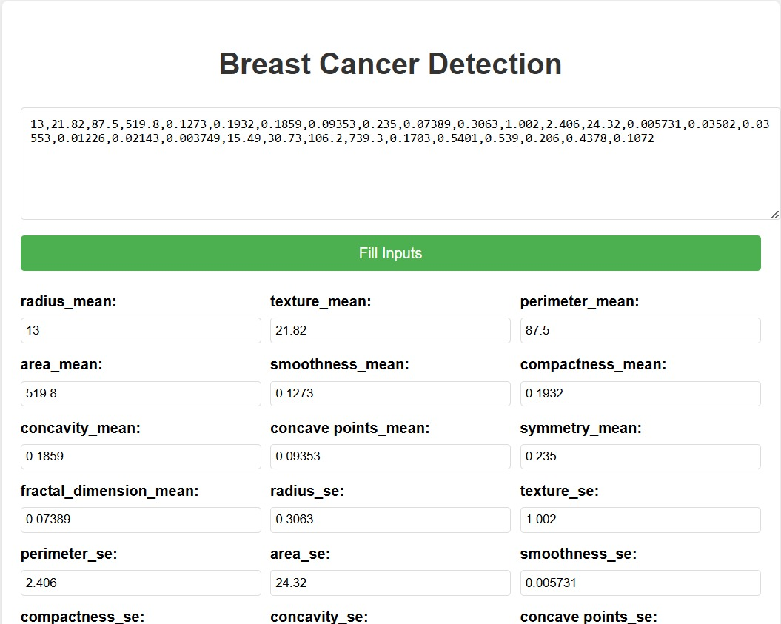
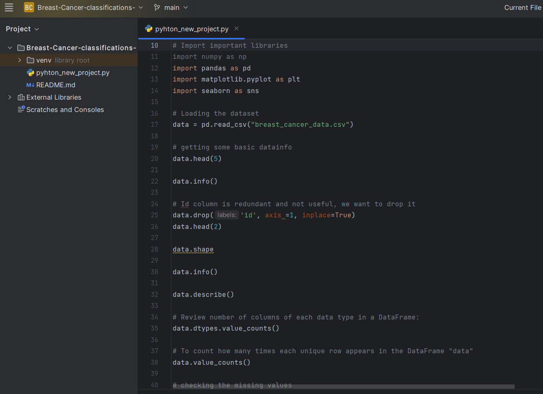
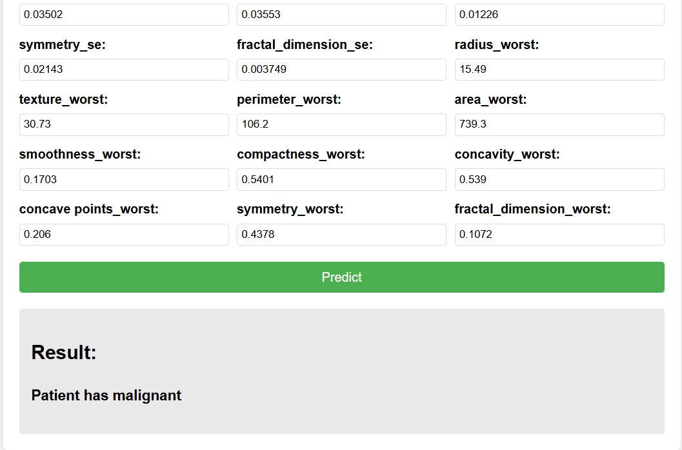
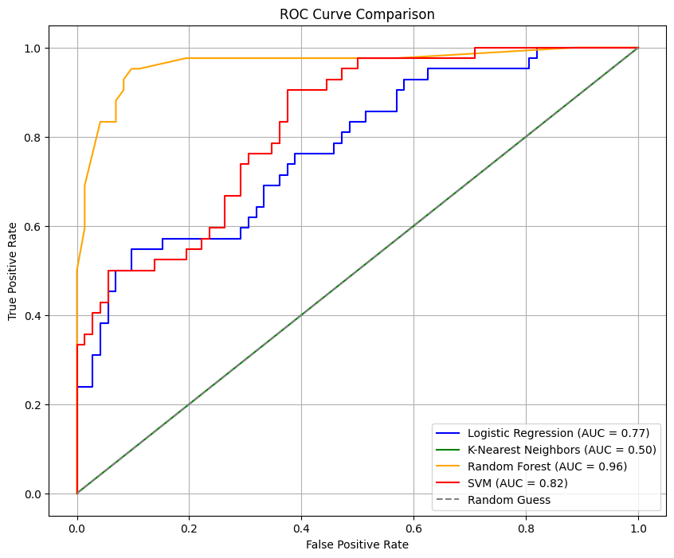
Visual Insights

Slide 8
Challenges Faced in the Project
Class Imbalance
Benign cases outnumber malignant ones, affecting model accuracy.
Computational Complexity
Model Interpretability
SVM: Slow during training.
KNN: High cost during inference (distance calculations).
KNN & SVM: High accuracy, but hard to explain.
Logistic Regression & Random Forest: Lower accuracy, better interpretability
Hyperparameter Optimization
Critical for model performance; adds computational overhead.

Slide 9
Conclusion
Model Implementation:
Machine learning models (Logistic Regression, Random Forest, and SVM) were used to classify breast cancer cases as benign or malignant.
Best Performing Model:
SVM achieved the highest accuracy (~94%) and effectively distinguished between the two classes.
Feature Insights:
Tumor characteristics like radius, perimeter, and area showed strong correlations with diagnosis, highlighting their importance in predictive modelling.

Slide 10
THANK YOU

